Slide 1
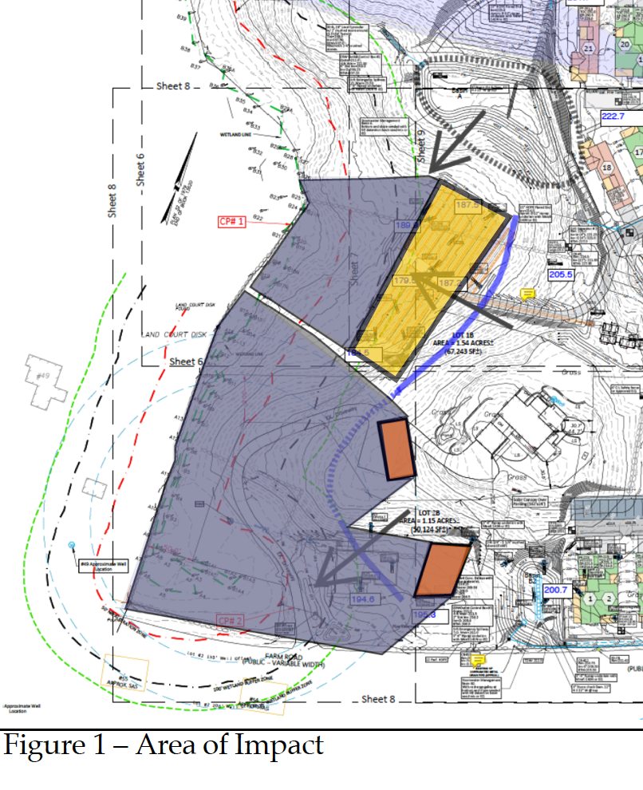
Scott Horsley Water Resources Consultant Retained by Brian and Mary Moore Farm Road 40B Review Presentation to Town of Sherborn March 20, 2024

Slide 2
Scott Horsley • Qualifications
30+ years experience a water resources consultant to USEPA, The Nature Conservancy, MADEP, states, municipalities, non-profit organizations and industry
Qualified as an Expert Witness as Hydrologist for U.S. Department of Justice (USDOJ) and USEPA in federal court, numerous state courts and administrative hearings
MADEP Stormwater Advisory Committee, Sustainable Water Management Initiative Committee, MADEP Title 5 Advisory Committee
Teaches graduate level courses in water resources management at Tufts University and Harvard University

Slide 3
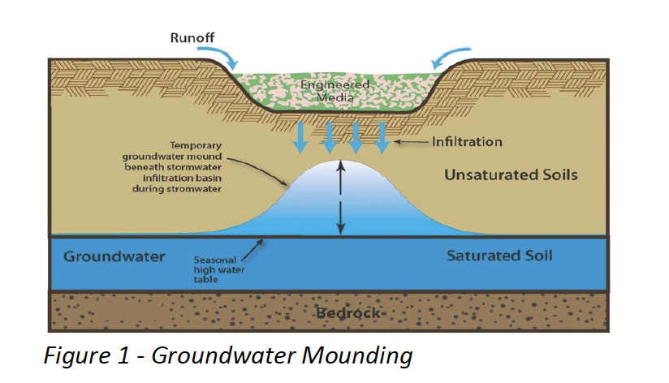
Critical Inputs to Grondwater Mounding Model 1. permeability (hydraulic conductivity) 2. saturated thickness

Slide 4
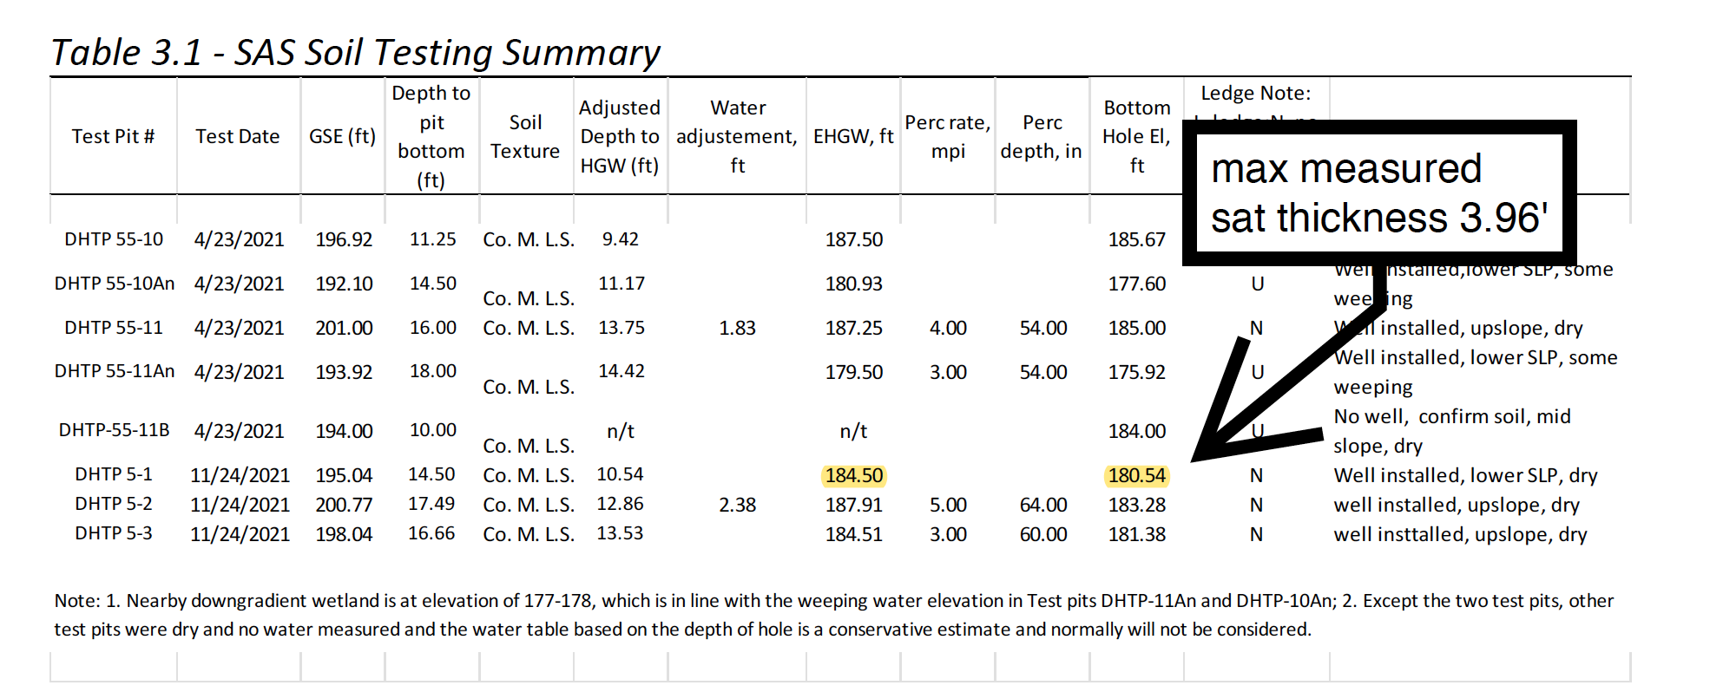
Groundwater Mounding Saturated Thickness CLWE used 14.5 feet

Slide 5
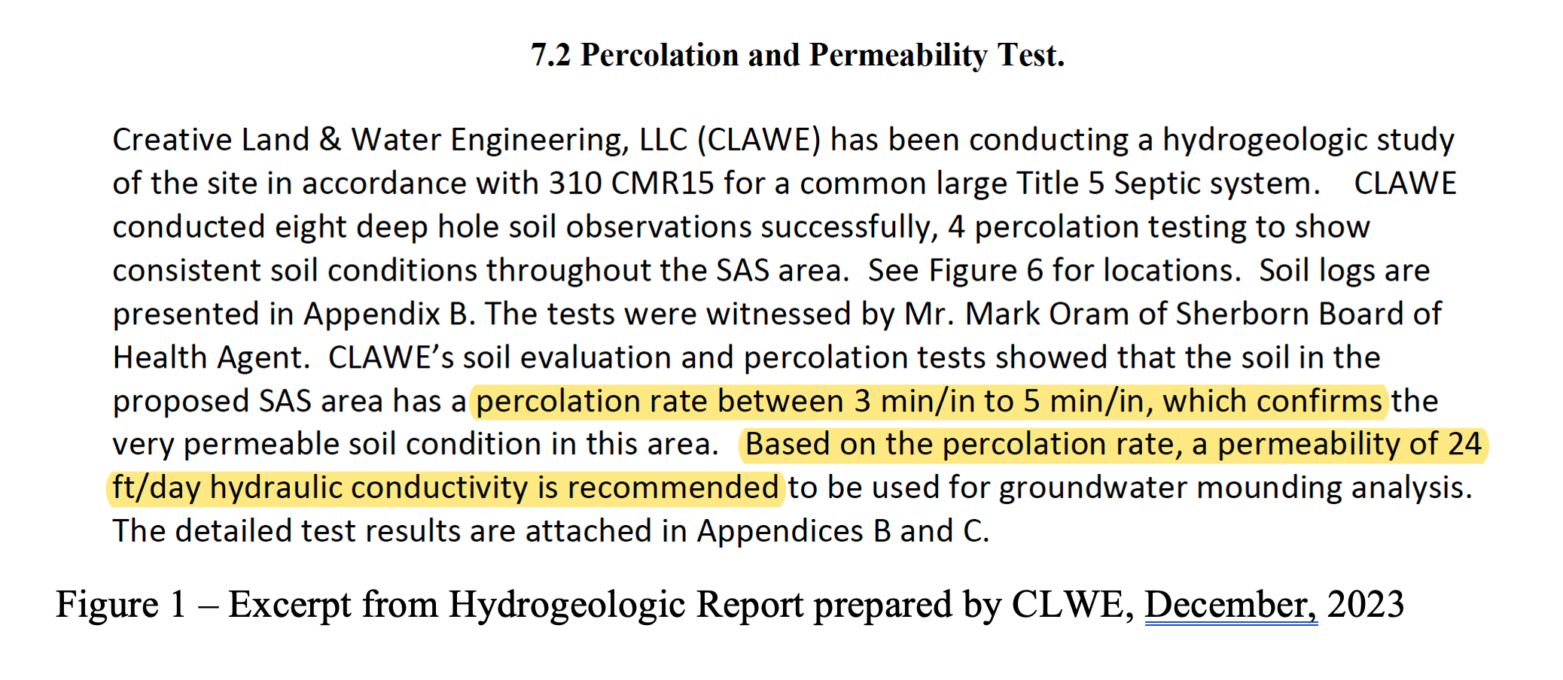

Slide 6
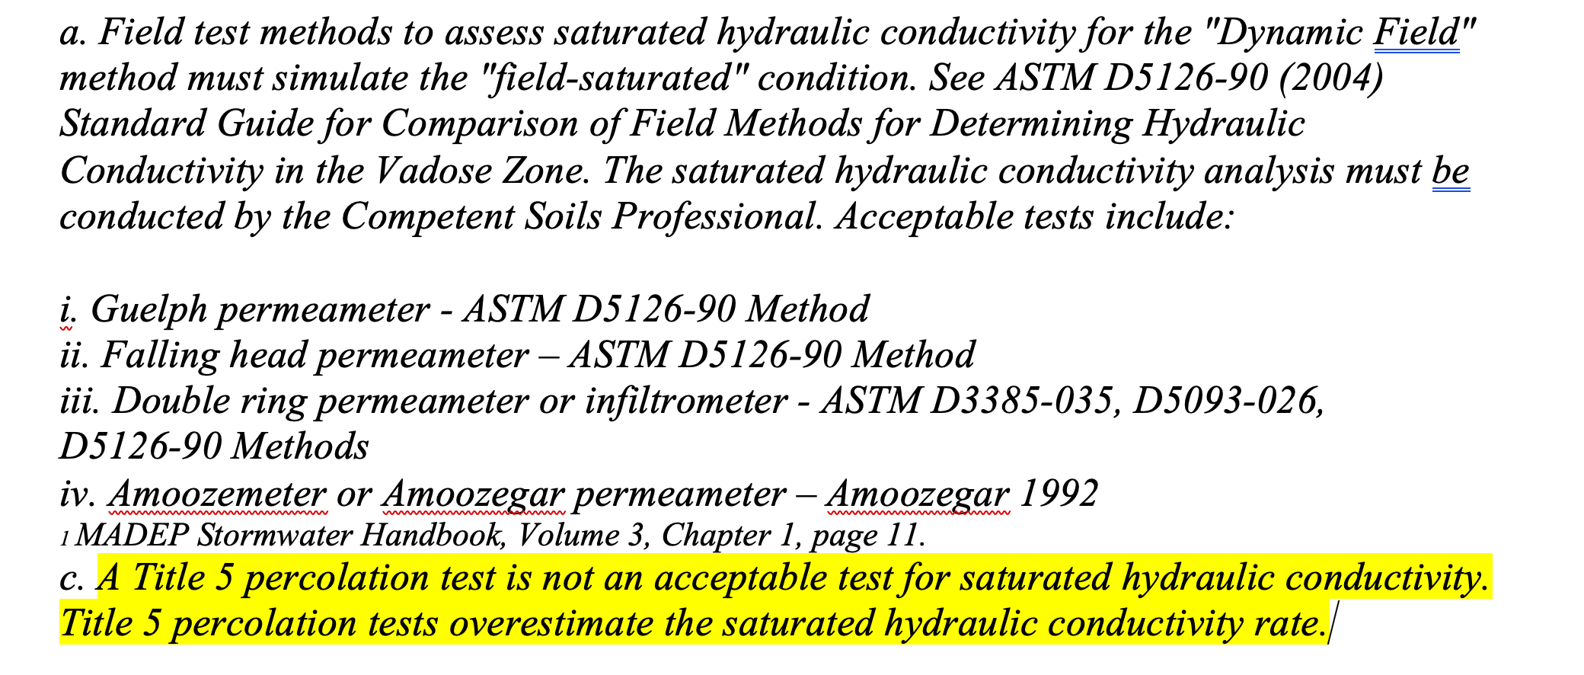
MADEP Stormwater Handbook, Volume 3, Chapter 1

Slide 8
MODFLOW model would provide better, more accurate analysis of groundwater flow net and nitrogen loading

Slide 9
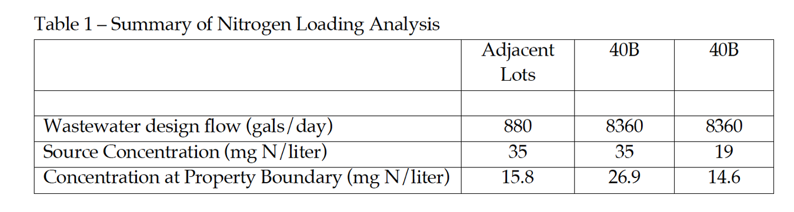
Federal & State Drinking Water Maximum Limit = 10 mg/liter

